Slide 1
Team 16
Knuckles, The Robotic Arm
Andrew Blanchard (Team Leader), Matthew van Zuilekom, Rym Benchaabane, Paola Hernandez
ECE 4336: ECE Systems Design
Faculty: Dr. Dmitri Litvinov
Faculty Advisor: Dr. Becker
Tuesday, March 5th 2019
Sponsored by Makerspace
Notes:
Andrew

Slide 2
Overall Project
What is Knuckles?
Assistive robotic arm that will hand the user requested objects and tools
Purpose
Increase the user’s productivity
Decrease the risk of dexterity incidents
Examples of users
Lab researchers
Elderly
People with disabilities
Notes:
Andrew

Slide 3
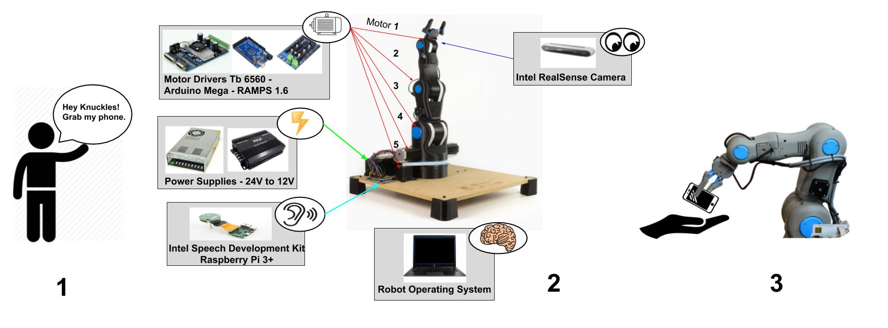
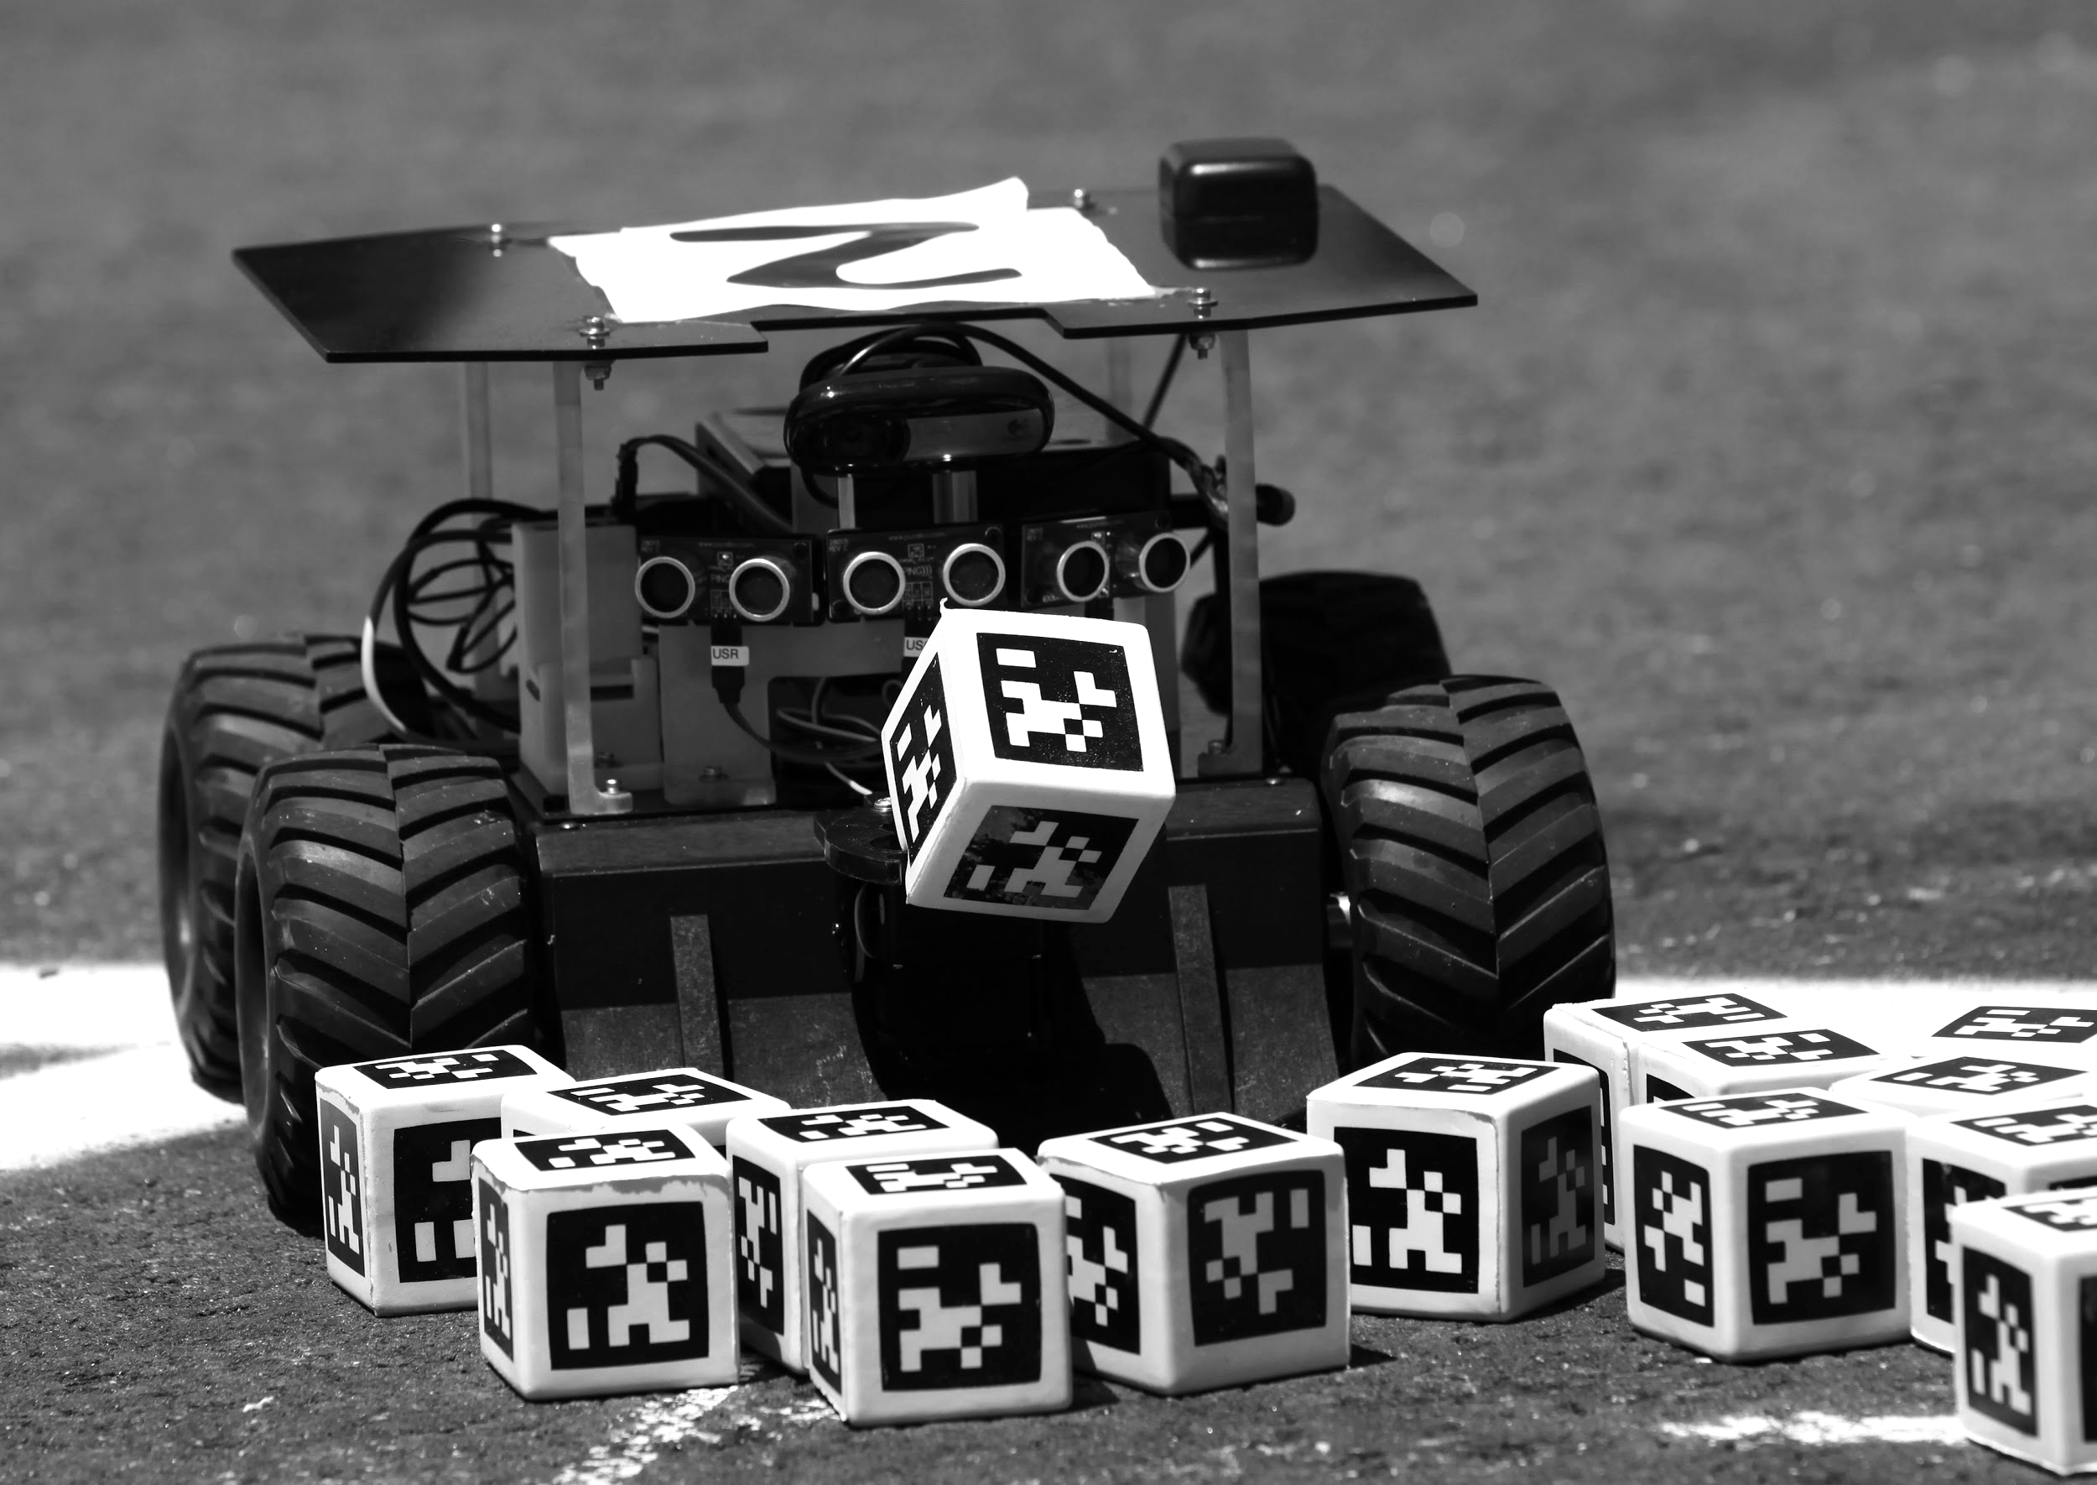

Overview Diagram
AprilTags
Figure 1. Overview of Knuckles functionalities
Notes:
Andrew

Slide 4
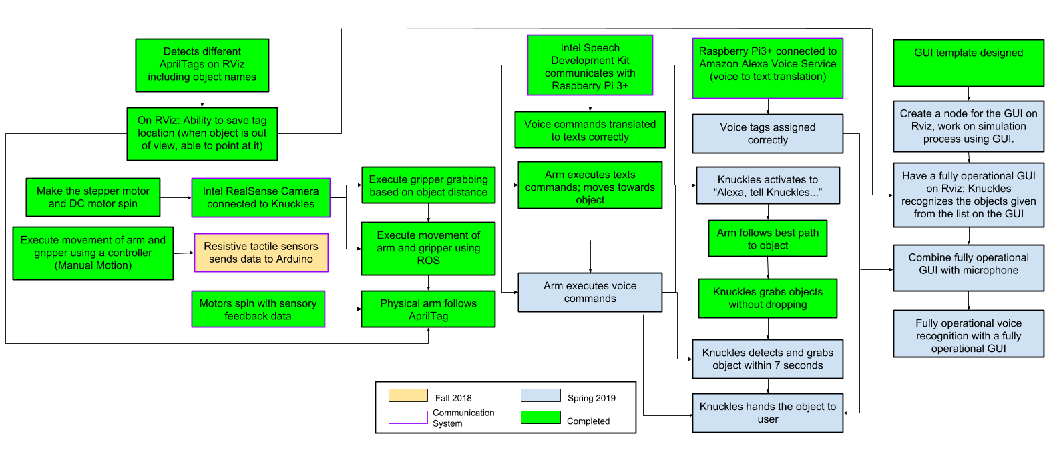
Target Objective - Goal Analysis
Figure 2. Goals and work progress
Notes:
Andrew

Slide 5
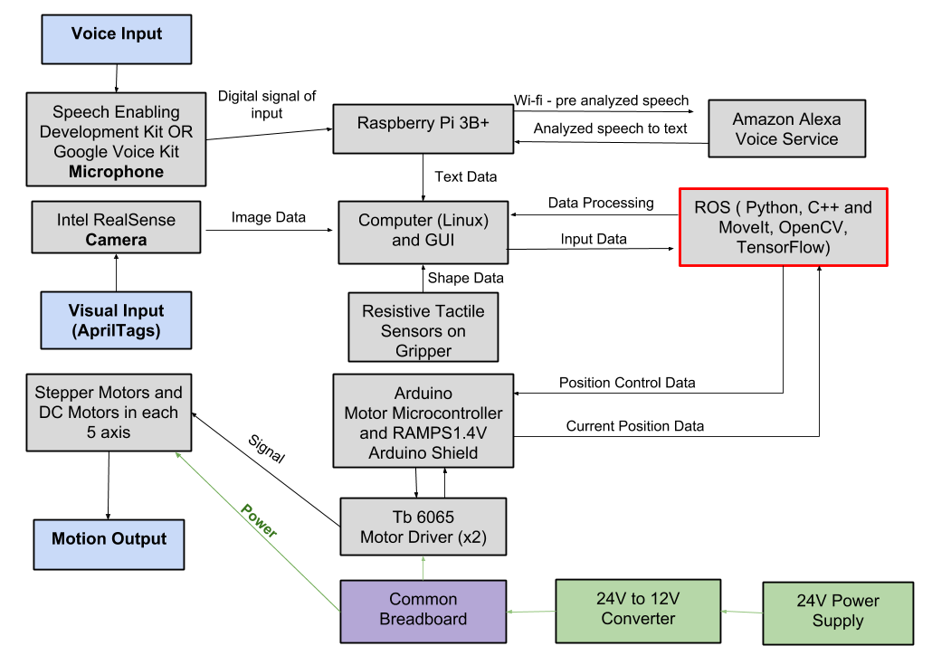
Design Considerations
Figure 3. Modular Diagram of Knuckles system
Notes:
Matthew

Slide 6
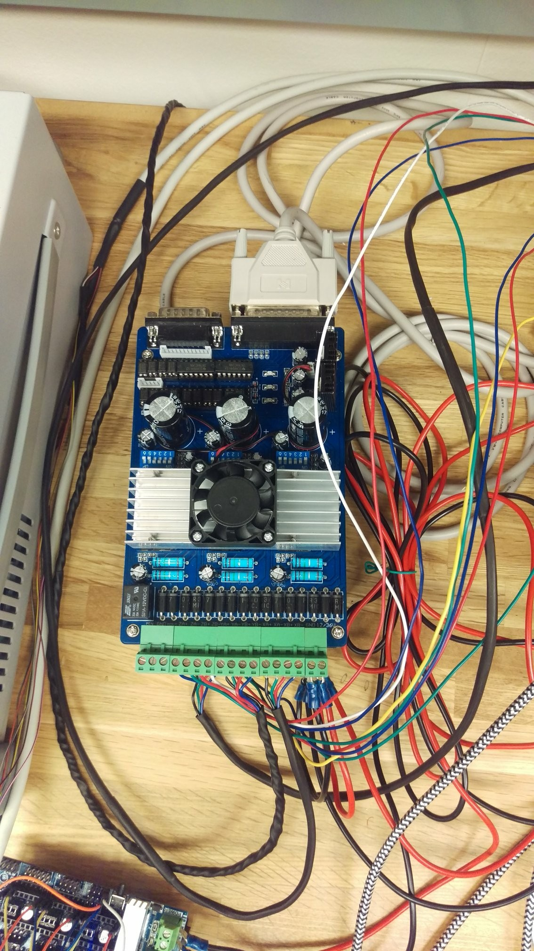
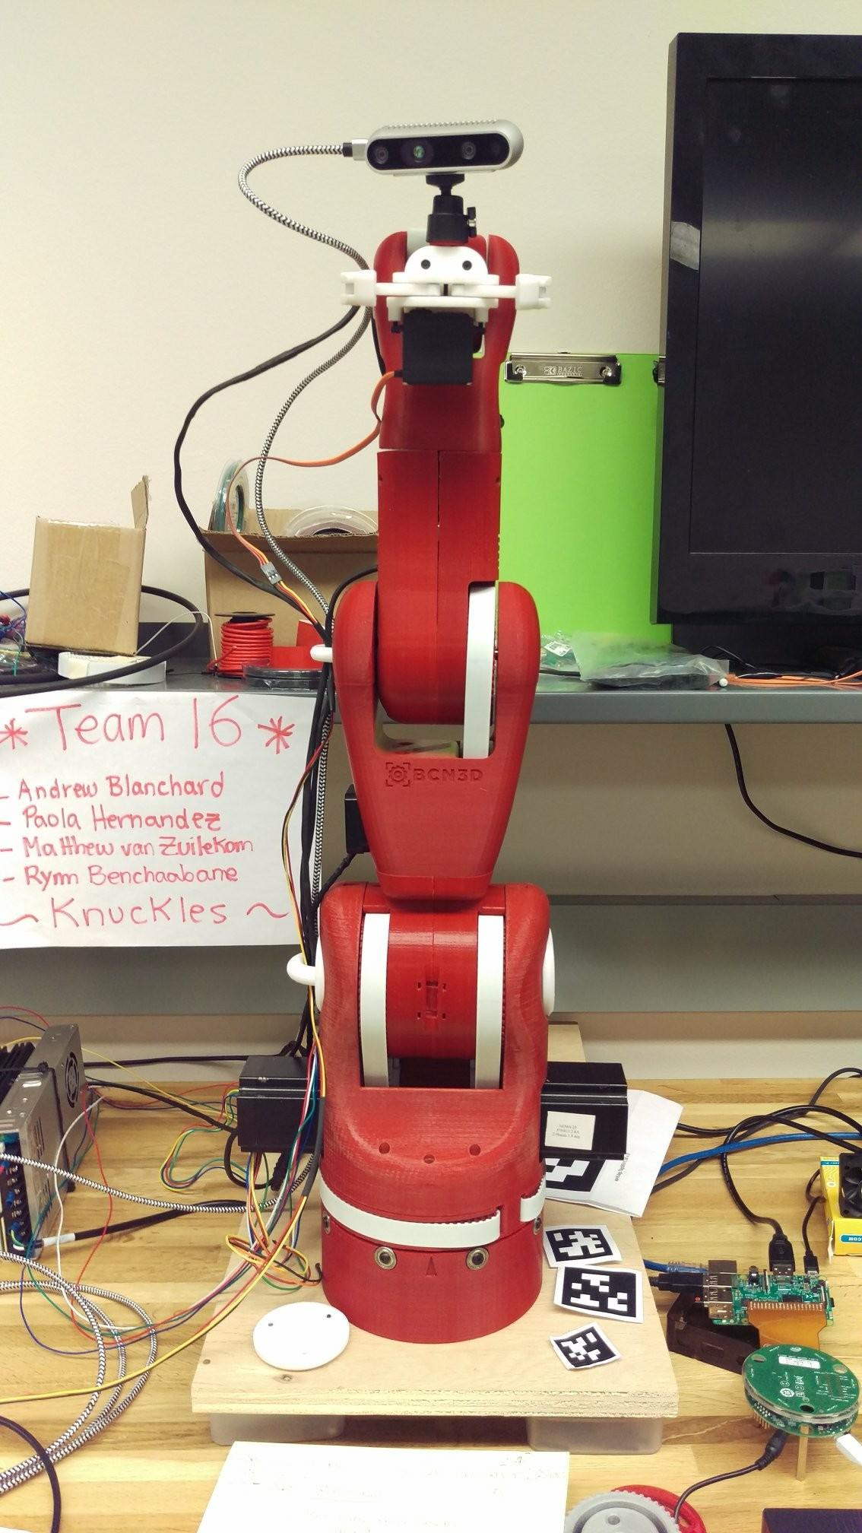
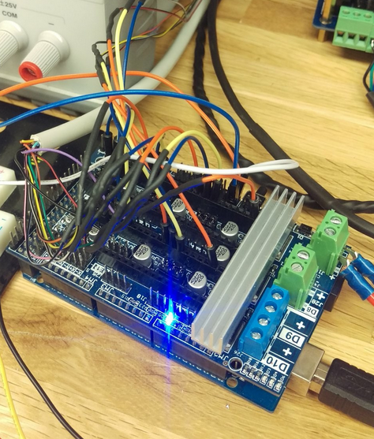
Figure 4. Arduino Mega 2560 + RAMPS V1.6 Pins connect to serial port inputs
Figure 5. Tb6560 stepper drivers
Figure 6. Knuckles, the robotic arm
Notes:
Matt

Slide 7
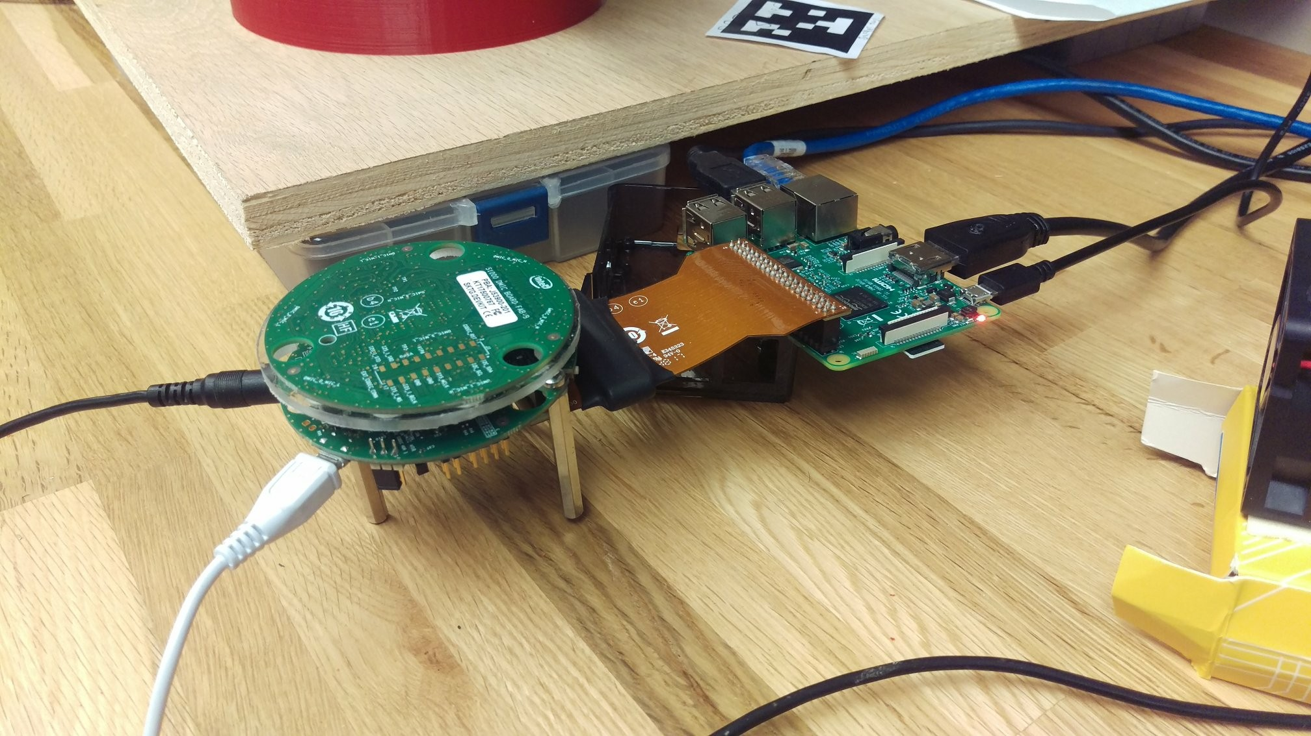
Figure 7. Raspberry Pi 3B+ and Speech Enabling Development Kit
Notes:
Matt

Slide 8
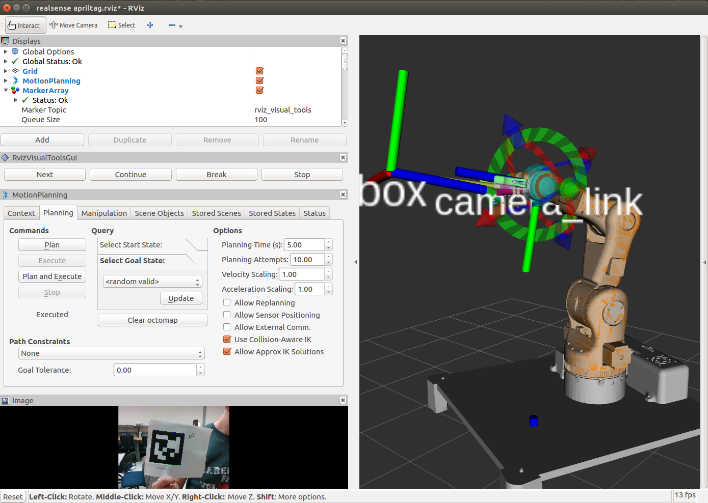
Figure 8. Knuckles model & AprilTag visualization on Rviz, ROS
Notes:
Matt

Slide 9
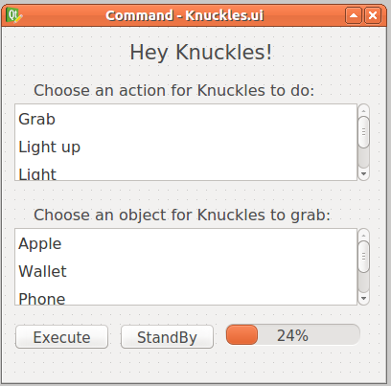
Graphical User Interface
(GUI)
Actions List:
Grab
Light Up
Light
Turn on Light
Place
Release
Take
Sleep
Object List:
Apple
Wallet
Phone
Banana
Tape
Bottle
AprilTag Cube
Bag of Chips
Notes:
Paola

Slide 10
Design Constraints
Limited time
Less time to optimize the gripper design to accommodate more shapes
Limited weight to lift
Notes:
Paola

Slide 11
Specifications
Degrees of Freedom (DOF) Arm – Five
Accuracy Voice Interpretation – 70%
Minimum Voltage for Motors – 12V
Object Detection – AprilTags
Object Count Library – 8
Response phrases - 64
Response Time – 7 seconds
Maximum Grabbing Reach – 0.7 meters
Maximum Weight Rating – 0.5 kG
Notes:
Paola

Slide 12
Features
Powered by Mains – Yes
Integrated Microphone – Yes
Integrated Camera – Yes
Object Detection – AprilTags
Voice-Controlled using Alexa Voice Service – Yes
GUI-Controlled – Yes
Wi-Fi required – Yes
Notes:
Paola

Slide 13
Deliverables
Table 1. Deliverables in Spring 2019
 | SPRING 2019
Assembling: Tune gripper and arm motors motion (100%) | User Interface: Develop a Graphic User Interface (QTdesigner) (50%)
Hardware Implementation Mount and install on Arm (Intel RealSense camera, Intel mic, tactile pads) (75%) | Automation Control: Arm moves using data from ROS (100%)
Object Detection: Arm follows AprilTag (100%) | Voice Recognition: Convert voice to speech speech to object detection (50%)
Communication System: Receive Feedback Signals from all hardware on ROS (66%) | Physical arm Prototype 2 (90%)
SPRING 2019
Notes:
Rym

Slide 14
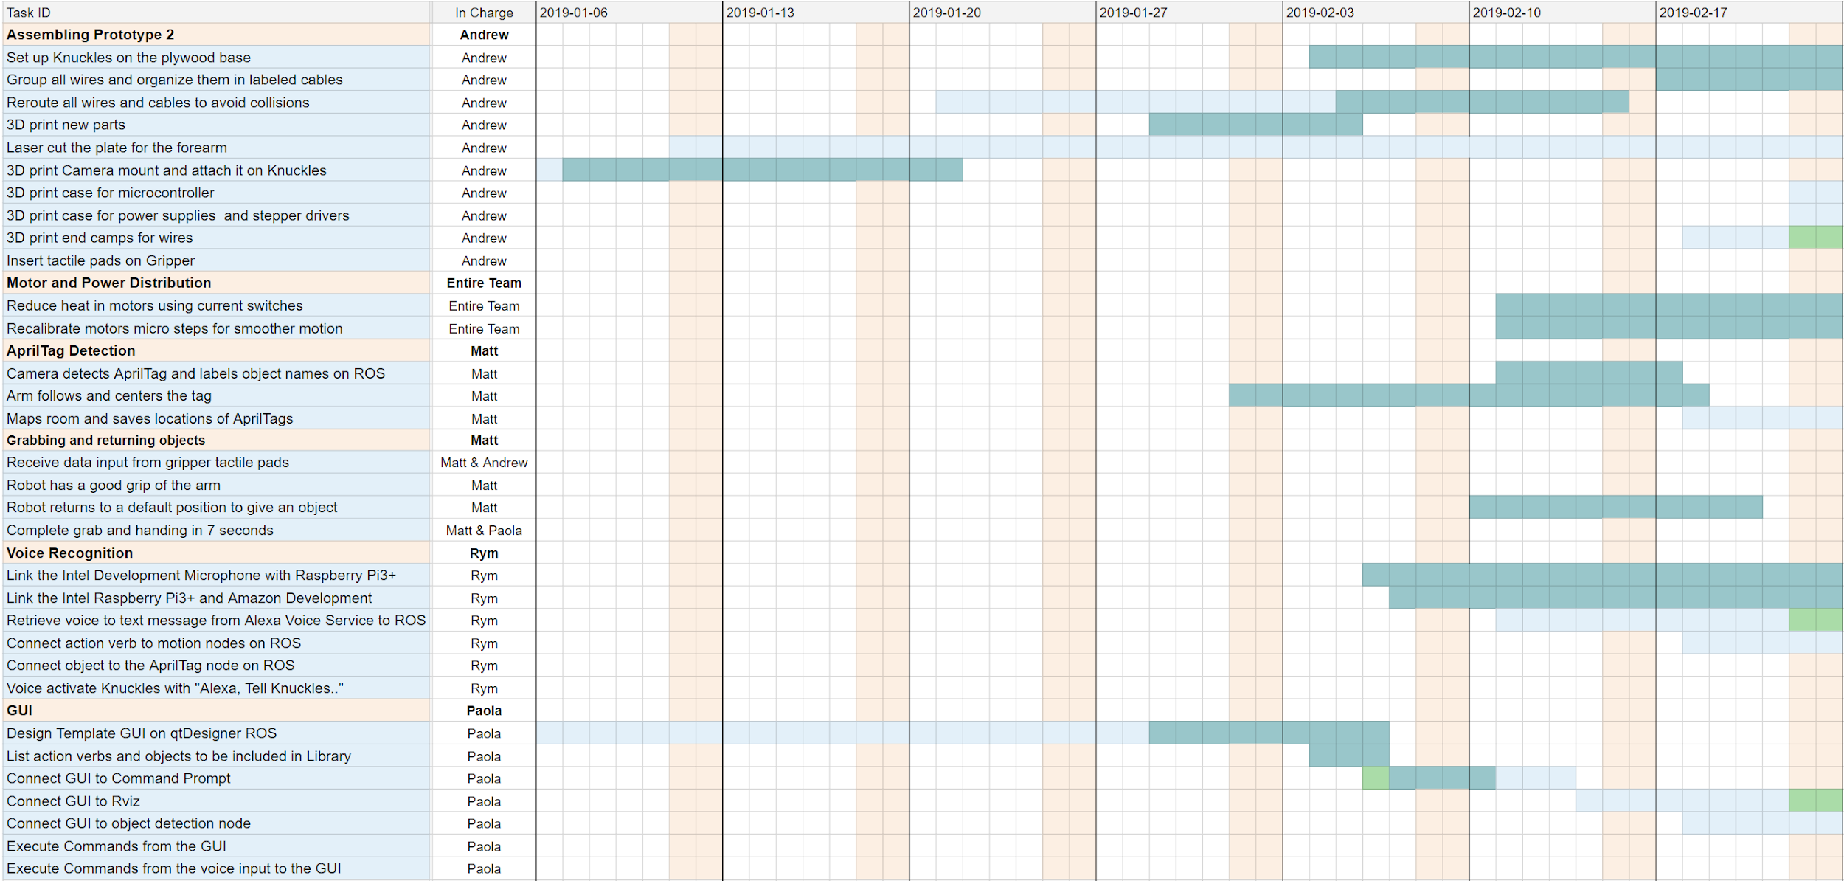
Gantt Chart - Spring
In Progress
Completed
Delay
ECEDHA Conference
Deadline
Notes:
Rym, also talk about Test Plan

Slide 15
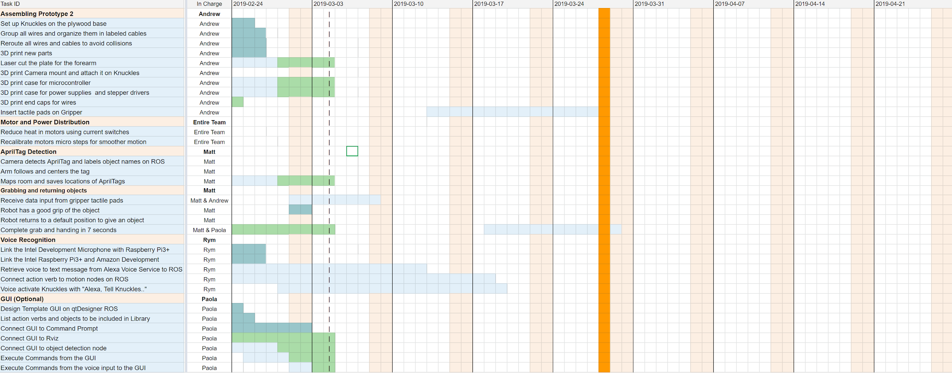
Gantt Chart - Spring
Completed
In Progress
Delay
ECEDHA Conference
Deadline
Notes:
Rym, also talk about Test Plan

Slide 16
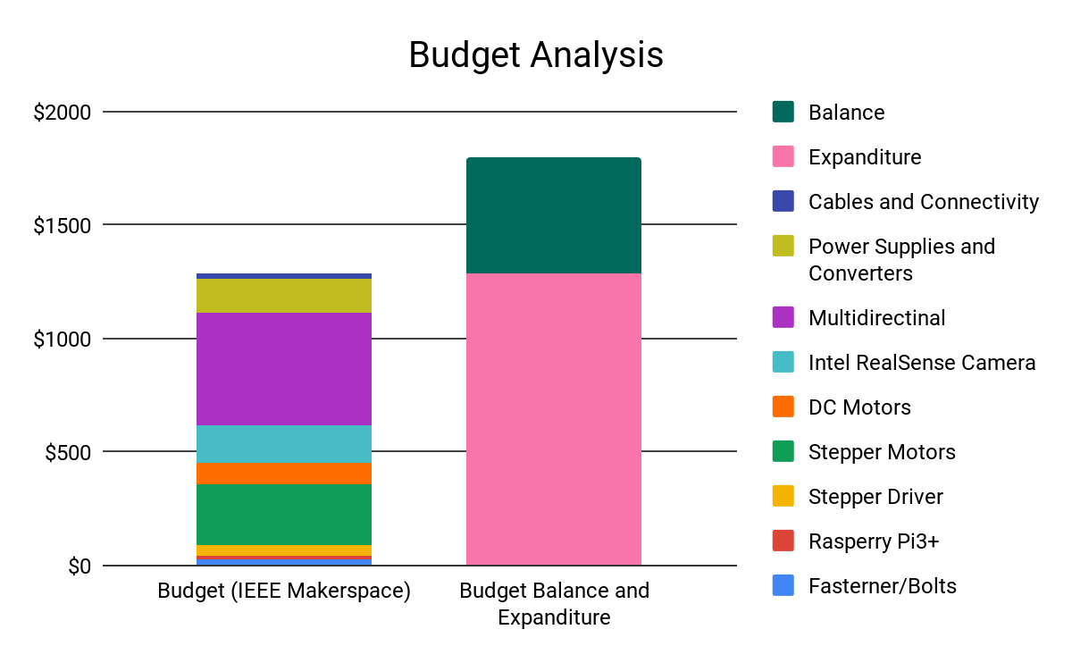
Total Budget
Thank you Makerspace, Dr. Roysam & Dr. Becker!
.
Total Budget: $1,800
Used 70.2%
Figure 9. Budget Table
Notes:
Rym

Slide 17
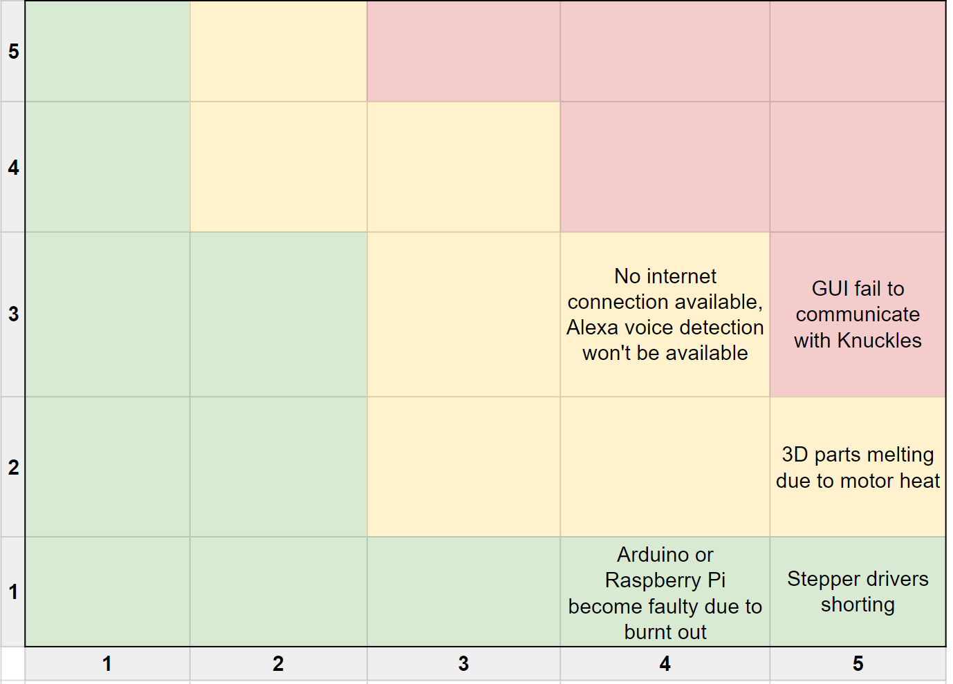
Risk Management Matrix
Probability
Consequence
Figure 10. Risk management matrix
Notes:
Matthew

Slide 18
Risk Mitigation
GUI fail to communicate with Knuckles
Voice to text input will still be functional
No internet connection available, Alexa voice detection unavailable
Text input will still be functional
3D parts melting due to motor heat
Can re-print melted parts
Stepper drivers shorting
Have four extra stepper drivers as replacements
Arduino or Raspberry Pi become faulty due to burnt out connections
Makerspace; can get replacements
Notes:
Matthew

Slide 19

Knuckles Recognizing and Retrieving an Object
Please click here to be redirected to the video.
Notes:
Matt

Slide 20
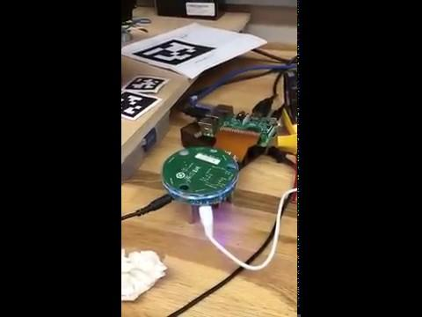
Talking to Alexa via Speech Development Kit
Please click here to be redirected to the video.
Notes:
Rym

Slide 21
Project Conclusion
Assistive robotic arm, increase productivity
Great opportunity to learn about robotics, Linux & ROS
Test plan
Modular plan will help us accomplish our goals
Current progress
Knuckles able to move to object and pick it up
Voice detection operational, need to convert to text
Second arm prototype almost complete
Notes:
Rym

Slide 22
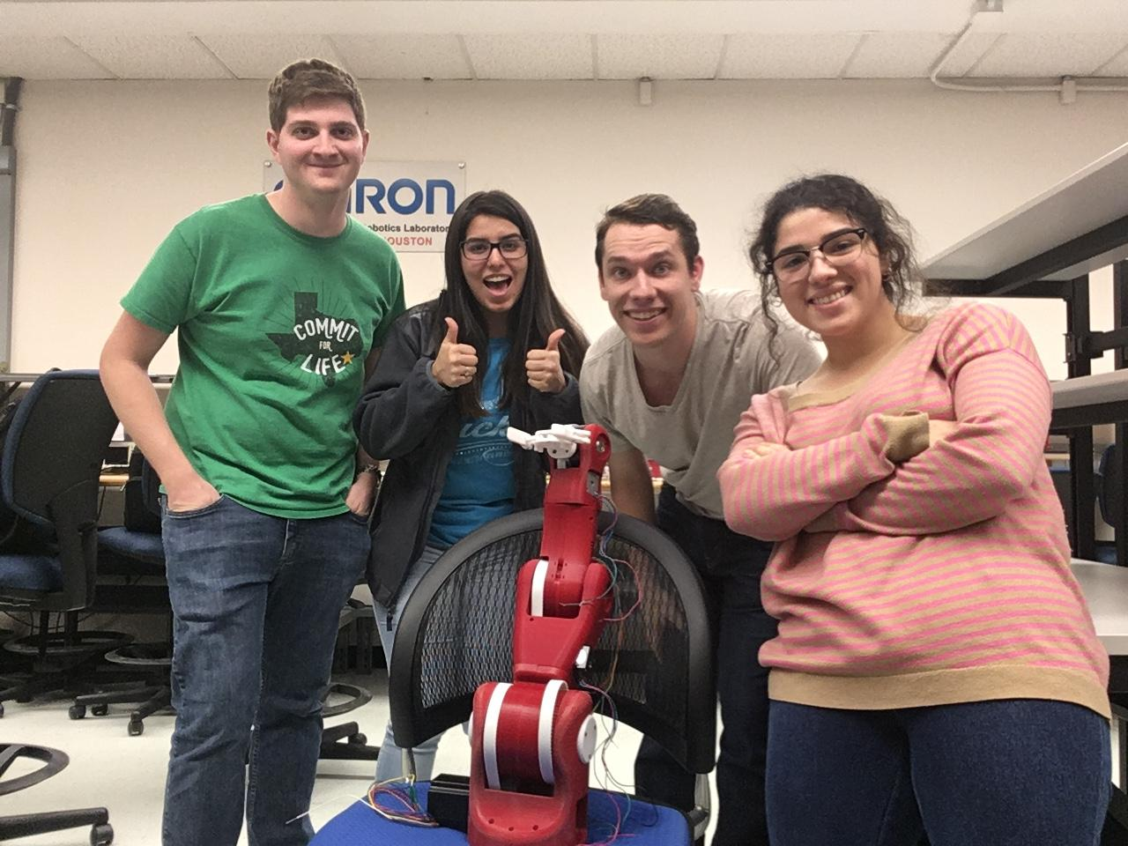
Thank you for your attention
QUESTIONS?
Notes:
Yay

